Slide 1
Portfolio PowerPoint Templates
Components library

Slide 2
Powerpoint Templates
When Word uses placeholder to target a customizable component, PowerPoint uses alternative text property of TextBox, Table or ChartArea
To see alternative text property of all component, you should activate « Size and Position » button in Powerpoint properties

Slide 3
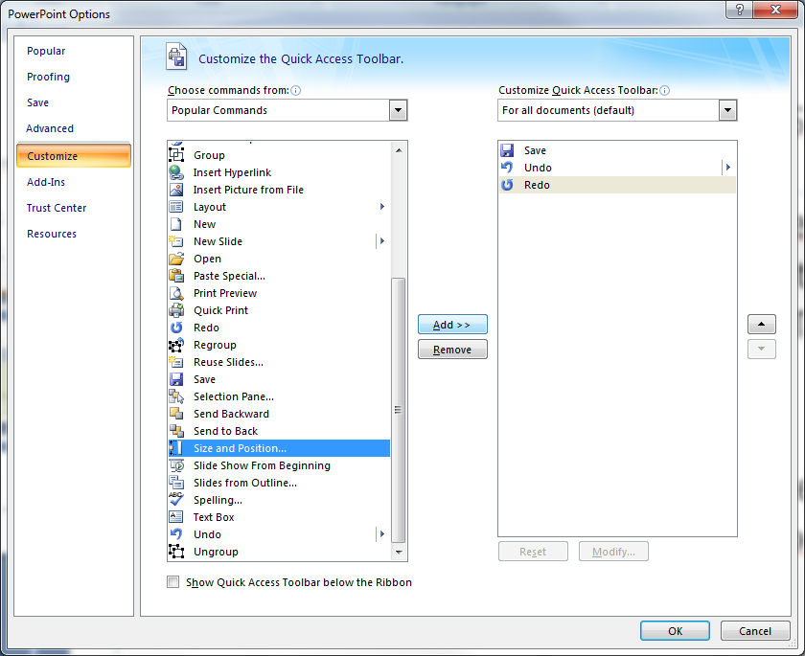
Powerpoint Templates

Slide 4
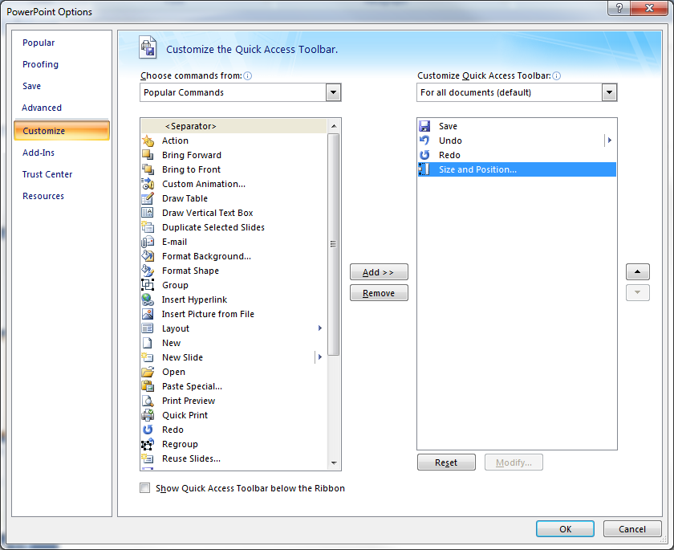
Powerpoint Templates

Slide 5
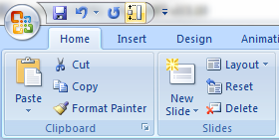
Powerpoint Templates
A new enabled button is now available on the top head of Powerpoint application
This button gives you the possibility to access to the alternative text property of all components

Slide 6
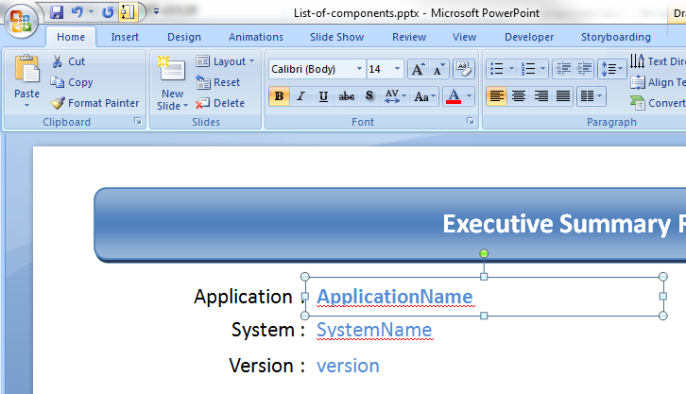
Powerpoint Templates
Now you can select a Shape and edit the alternative text property value

Slide 7
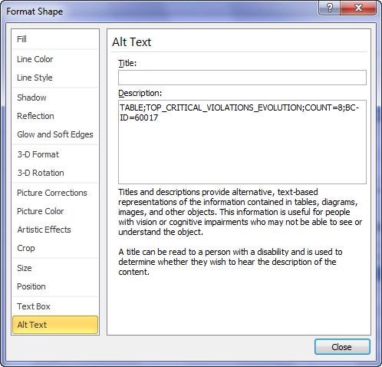
Powerpoint Templates
Then, type and name of component and then options can be configured in the area below.

Slide 8
PowerPoint Templates
Text Templates

Slide 9
PowerPoint Templates – Text
This kind of template is identified by a type value as
Type = TEXT

Slide 10
PowerPoint Templates – Text
Category
Block Name :
PF_CATEGORY_NAME
Note :
If no category selected, « all » value is displayed
→
CategoryName
Tag
Block Name :
PF_TAG_NAME
Note :
If no tag selected « all » value is displayed
→
TagName
Number of apps
Block Name :
TEXT;PF_#APPLICATIONS
Options :
none
→
numberOfApps

Slide 11
PowerPoint Templates – Text
Technical Debt ratio per AFP – deprecated (old Cast formula)
Block Name :
PF_TECHDEBT_VS_AFP
Options :
none
→
Value
Technical Debt ratio per LOC - deprecated (old Cast formula)
Block Name :
PF_TECHDEBT_VS_LOC
Options :
none
→
Value
Critical Violations
Block Name :
TEXT;PF_CRITICAL_VIOLATIONS
Options :
BCID=N (where N is an health factor (by default 60017)
→
Value

Slide 12
PowerPoint Templates – Text
OMG Technical Debt ratio per AFP
Display the total of OMG technical debt per AFP in Days
Block Name :
PF_OMG_TECHDEBT_VS_AFP
Options :
ID=ISO or AIP or CISQ (ISO by default if not present)
→
Value
OMG Technical Debt ratio per KLOC
Display the total of OMG technical debt per KLOC in Days
Block Name :
PF_OMG_TECHDEBT_VS_KLOC
Options :
ID=ISO or AIP or CISQ (ISO by default if not present)
→
Value
ISO option is the recommended technical debt to be used. Requires installation of OMG Technical Debt Measure (>2.0.0 funcrel) and ISO-5055 Index extensions during analysis
CISQ option required installation of OMG Technical Debt Measure and CISQ Index extensions during analysis. Scope of rules is reduced

Slide 13
PowerPoint Templates – Text
Custom Expression
Block Name :
PF_CUSTOM_EXPRESSION
Options :
- PARAMS=SZ a SZ b, (SZ pour sizing measure, QR pour quality rule, BF for background fact)
- EXPR=b/a, (operators can be +, -, *, / , (, ) )
- a=67011,
- b=67010,
- FORMAT=N0 (N2 by default, if nothing or erroneous format is set),
- AGGREGATOR=SUM|AVERAGE (for portfolio component, to aggregate results of all applications for the custom expression, AVERAGE by default or if erroneous format is set)
→
Value
You can have as number of parameters as you want (theorical limit is 16383…).
The format of return value is explained here : https://msdn.microsoft.com/en-us/library/dwhawy9k.aspx, with examples for double here : https://msdn.microsoft.com/en-us/library/kfsatb94.aspx ), only N format is interesting here :
N: -195,489,100.84
N0: -195,489,101
N1: -195,489,100.8
N2: -195,489,100.84
/!\ don’t put blank char in the definition of parameters (,a=67011,b=67010,c=…)

Slide 14
PowerPoint Templates
Graphic Templates

Slide 15
PowerPoint Templates – Graphics
This kind of template is identified by a type value as
Type = GRAPH

Slide 16
PowerPoint Templates – Graphics
Technical Debt Trending Progression - deprecated (old Cast formula)
Block Name :
PF_TREND_TECH_DEBT
Options :
none
Note :
X axis is based on the last 6 previous quarter starting from today

Slide 17
PowerPoint Templates – Graphics
PowerPoint Templates – Graphics
OMG Technical Debt Trending Progression
Display the trend of OMG Technical Debt in Days
Block Name :
PF_TREND_OMG_TECH_DEBT
Options :
ID=ISO or AIP or CISQ (ISO by default if not present)
Note :
X axis is based on the last 6 previous quarter starting from today
ISO option is the recommended technical debt to be used. Requires installation of OMG Technical Debt Measure (>2.0.0 funcrel) and ISO-5055 Index extensions during analysis
CISQ option required installation of OMG Technical Debt Measure and CISQ Index extensions during analysis. Scope of rules is reduced

Slide 18
PowerPoint Templates – Graphics
Critical Violations Delta Trending Progression
Block Name :
PF_TREND_CRIT_VIOL
Options :
BCID=N (where N is an health factor (by default 60017)
Note :
X axis is based on the last 6 previous quarter starting from today

Slide 19
PowerPoint Templates – Graphics
Only working with Powerpoint 2013, after report generated, need to edit data in exel to get label of applications updated into the graph
TQI Score by Critical Violations/LoC by AFP
Block Name :
PF_QS_BY_CVLOC
Note :
Bubble = application, Size of bubble = AFP

Slide 20
PowerPoint Templates – Graphics
List of applications regarding a specific indicator
Block Name :
PF_BAR_CHART
Options :
METRIC=ID (where ID can be a quality indicator or a background fact)

Slide 21
PowerPoint Templates
Table Templates

Slide 22
PowerPoint Templates – Tables
This kind of template is identified by a type value as
Type = TABLE

Slide 23
PowerPoint Templates – Tables
Top Riskiest Application regarding Health Factor
Block Name :
PF_TOP_RISKIEST_APPS
Options :
COUNT=N (by default COUNT=5)
where N indicates the number of top N
ALT=N (where N is an health factor id - eg. 60017)
Application Name | Critical Violations | TQI | Last Analysis Date
App 1 | 0 | 0.00 | 1 jan 2010
App 2 | 0 | 0.00 | 1 jan 2010
App 3 | 0 | 0.00 | 1 jan 2010
App 4 | 0 | 0.00 | 1 jan 2010
App 5 | 0 | 0.00 | 1 jan 2010

Slide 24
PowerPoint Templates – Tables
SLA View
Block Name :
PF_BC_RELEASE_PERFORMANCE
Options :
BF=T1 T2 T3 T4 T5 T6 T7 T8 where Tx is a target to fix regarding each line
SLA=X Y where X is corresponding to the 2% and Y is corresponding to the 5% in the formula below
Note :
-SLA Assessment thresholds
Good if % difference between Target and Actual is less than 2%
Acceptable if & difference between Target and Actual is between 2% and 5%
Poor if % difference between Target and Actual is greater than 5%
-Actual score: for each app, score from latest snapshot (even if snapshot date is before current quarter), then average for all apps
-Target score: score to reach, to be configured as an option of the component.
-Previous quarter: for each app, score from latest snapshot in previous quarter (even if snapshot date is before previous quarter). then average for all apps
Application Quality Measure | Previous quarter | Target score | Actual score | SLA Assessment
Robustness | 0.00 | 0.00 | 0.00 | Good
Security | 0.00 | 0.00 | 0.00 | Good
Efficiency | 0.00 | 0.00 | 0.00 | Good
Changeability | 0.00 | 0.00 | 0.00 | Good
Transferability | 0.00 | 0.00 | 0.00 | Good
Programming Practice | 0.00 | 0.00 | 0.00 | Good
Documentation | 0.00 | 0.00 | 0.00 | Good
Architecture/Design | 0.00 | 0.00 | 0.00 | Good

Slide 25
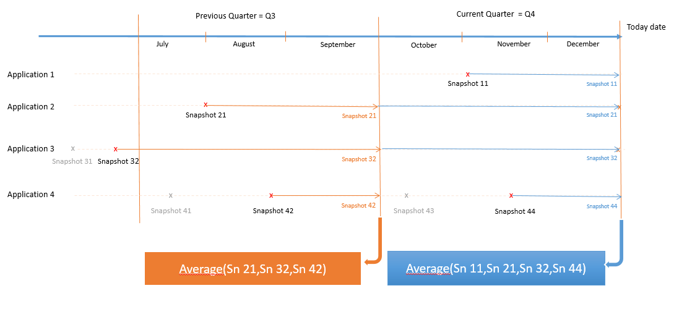
PowerPoint Templates – Tables
Block Name :
PF_BC_RELEASE_PERFORMANCE & PF_TABLE_RELEASE_PERFORMANCE
Illustration to explain how scores are calculated

Slide 26
PowerPoint Templates – Tables
Generic SLA View
Block Name :
PF_TABLE_RELEASE_PERFORMANCE
Options :
ID=ID1|ID2|ID3… where Idx is the metric id of the quality indicator (BC, TC or QR) to assess
TARGETS=T1|T2|T3… where Tx is a target to fix regarding each line, if only one target, it will be used for all metrics
SLA=X|Y where X is corresponding to the a% and Y is corresponding to the b% in the formula below
Note :
-SLA Assessment thresholds
Good if % difference between Target and Actual is less than a%
Acceptable if & difference between Target and Actual is between a% and b%
Poor if % difference between Target and Actual is greater than b%
-Actual score: for each app, score from latest snapshot (even if snapshot date is before current quarter), then average for all apps
-Target score: score to reach, to be configured as an option of the component.
-Previous quarter: for each app, score from latest snapshot in previous quarter (even if snapshot date is before previous quarter). then average for all apps
Application Quality Measure | Previous quarter | Target score | Actual score | SLA Assessment
Total Quality Index | 0.00 | 0.00 | 0.00 | Good
Efficiency - Expensive Calls in Loops | 0.00 | 0.00 | 0.00 | Good
Avoid large Classes - too many Methods (JEE) (4554) | 0.00 | 0.00 | 0.00 | Good
Avoid Classes with a very low comment/code ratio (7780) | 0.00 | 0.00 | 0.00 | Good

Slide 27
PowerPoint Templates – Tables
Identification of ignored Applications or snapshots
Blocks Name :
PF_IGNORED_APPLICATIONS
PF_IGNORED_SNAPSHOTS
Options :
none
The following block provides potential applications or snapshots of application that didn’t work during the with other blocks generation. Investigation into the central schema for the application or snapshot listed must be done.
Ignored Apps
App 1
App 2
App 3
App 4
App 5
Ignored Snapshots
Snap 1 HReF
Snap 2 HReF
Snap 3 HReF
Snap 4 HReF
Snap 5 HReF

Slide 28
PowerPoint Templates – Tables
Name | Id
Total Quality Index | 60017
Security | 60016
Robustness | 60013
Performance | 60014
Changeability | 60012
Transferability | 60011
ProgrammingPractices | 66031
ArchitecturalDesign | 66032
Documentation | 66033
SEIMaintainability | 60015
CostComplexityDistribution | 67001
CyclomaticComplexityDistribution | 65501
OOComplexityDistribution | 65701
SQLComplexityDistribution | 65801
CouplingDistribution | 65350
ClassFanOutDistribution | 66020
ClassFanInDistribution | 66021
SizeDistribution | 65105

